Slide 1






Towards Testing ACID Compliance in the LDBC Social Network Benchmark
Jack Waudby, Benjamin A. Steer, Karim Karimov, József Marton, Peter Boncz, and Gábor Szárnyas

Slide 2
Linked Data Benchmark Council
LDBC is a non-profit organization established in 2012, dedicated to defining benchmarks and auditing results for graph data management software.
Similar goals to TPC’s in the relational domain:
facilitate fair comparison
drive competition
capture an understanding of the field

Slide 3
LDBC Structure
Task Forces;
Social Network Benchmark
Semantic Publishing Benchmark
Graphalytics
Working Groups;
Property Graph Schema
Query Language (G-CORE)
Formal Semantics (GQL)
Existing Languages (literature review)
Membership;
Non-profit orgs (ENS-Paris, University of Edinburgh)
Commercial orgs (TigerGraph, Neo4j, Oracle, OpenLink Software, Ontotext, JCC Consulting, Intel)
Individual members
Associate members

Slide 4
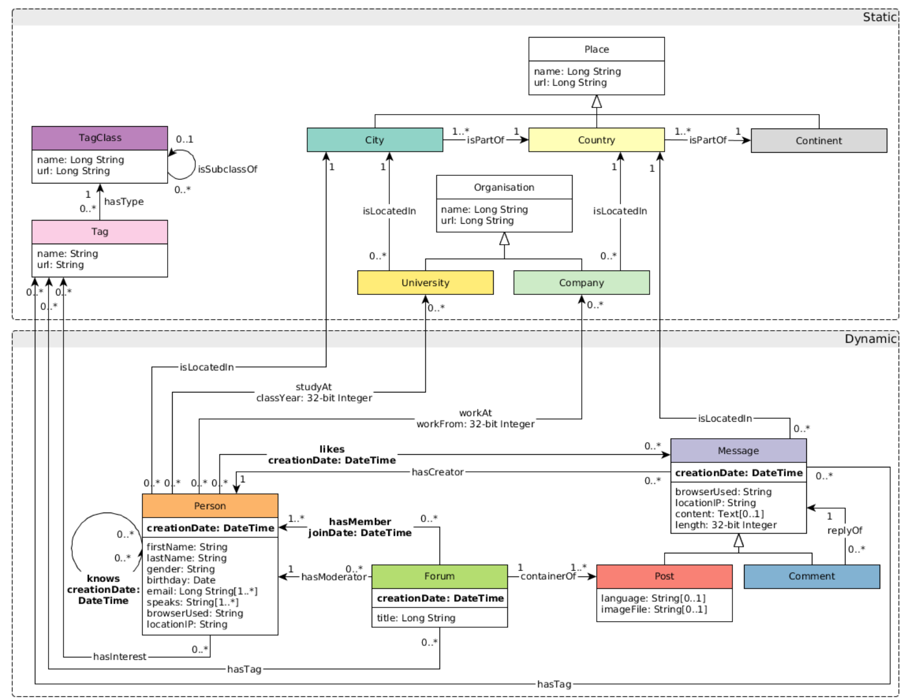
LDBC Social Network Benchmark (SNB) Suite
Models a social network, e.g., Facebook
People connect with each other and post messages in groups
Correlated synthetic data produced by LDBC’s Datagen
2 workloads; Interactive and Business Intelligence (BI)

Slide 5
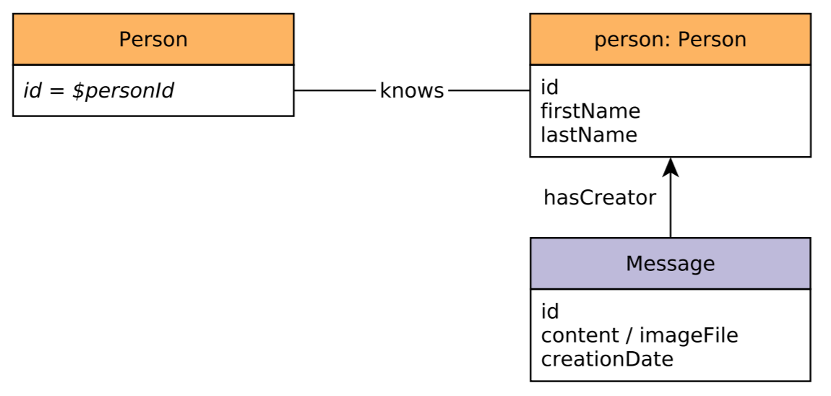
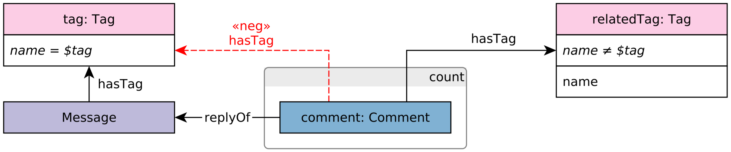
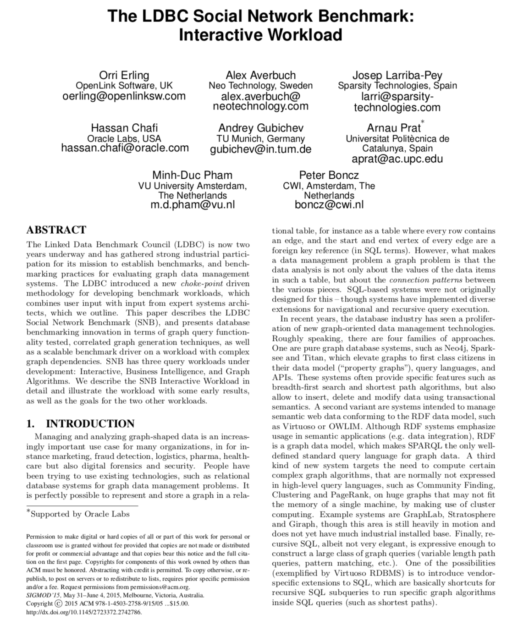
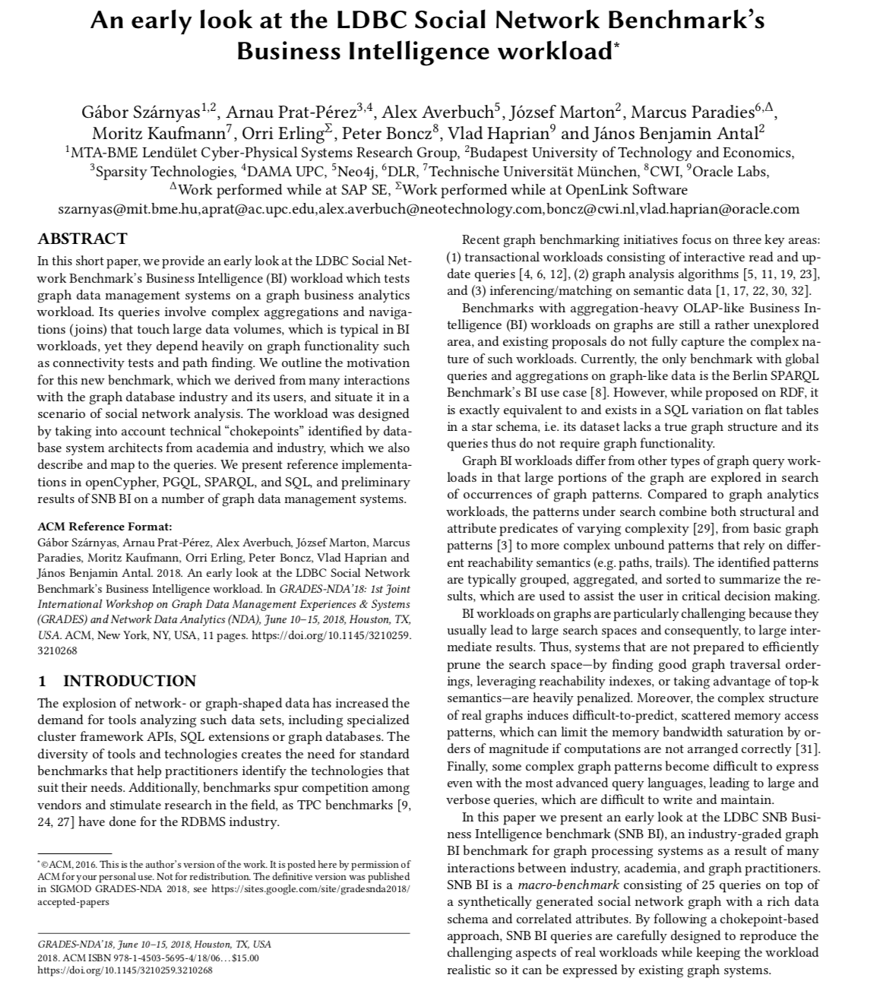
LDBC Social Network Benchmark (SNB) Suite
Interactive (OLTP)
complex/short read queries, updates
explore neighborhood of a node/query
established, multiple implementations
BI (OLAP)
currently read-only queries
large portion of the graph/query
ongoing adoption
Erling et al.
The LDBC Social Network Benchmark: Interactive Workload,
SIGMOD 2015
Szárnyas et al.
An early look at the LDBC Social Network Benchmark’s Business Intelligence Workload,
GRADES-NDA 2018
Notes:
Interactive targets transactional graph processing systems
Goal: facilitate the maturing of transactional graph data management systems

Slide 6

Motivation
Starting receiving requests for audits;
first audit completed July 2020, FMA’s TuGraph
ACID compliance important for fair comparison between systems
No mechanism for validating ACID compliance*
→ Design an ACID compliance test suite
→ Focus on Atomicity and Isolation
*Durability test already part of benchmark specification

Slide 7
Related Work
TPC-* Tests: assume lock-based concurrency control, tests for 3 isolation anomalies → not generalizable, limited anomaly test coverage
Hermitage (Martin Kleppmann) tests performed by hand → hard to induce anomalies that relied on fast timings
Jepsen (Kyle Kingsbury) focuses on distributed systems under various failure modes → too heavyweight

Slide 8
Design Considerations
Disclaimer: verifying ACID compliance with a finite set of tests is not possible
Generalizable – agnostic of system-level implementation details and query API
Lightweight – not add significant overhead to benchmarking process
Improved Coverage – test for more isolation anomalies, e.g., lost updates, write skew

Slide 9
LDBC ACID Test Suite
Included in benchmark workflow as an additional step in the Validation Phase
Data Generation
Validate Workload Transaction Profiles
Validation
ACID Tests
Benchmark Execution

Slide 10
LDBC ACID Test Suite Design
Based solely on client observations to detect anomalies (generalizable)
Each test consists of a handcraft set of transactions, which when interleaved create conditions in an anomaly could occur
After execution, transaction results are gathered, and an anomaly check performed
Transaction Type A
Client 1
Have I observed an anomaly?
Store Result
…
DB
Client N
Transaction Type B

Slide 11
LDBC ACID Test Suite Execution Flow
For each test;
Load required test graph
Initiate N clients
Execute test’s transaction set for duration T
Gather transaction results from clients
Perform anomaly check

Slide 12
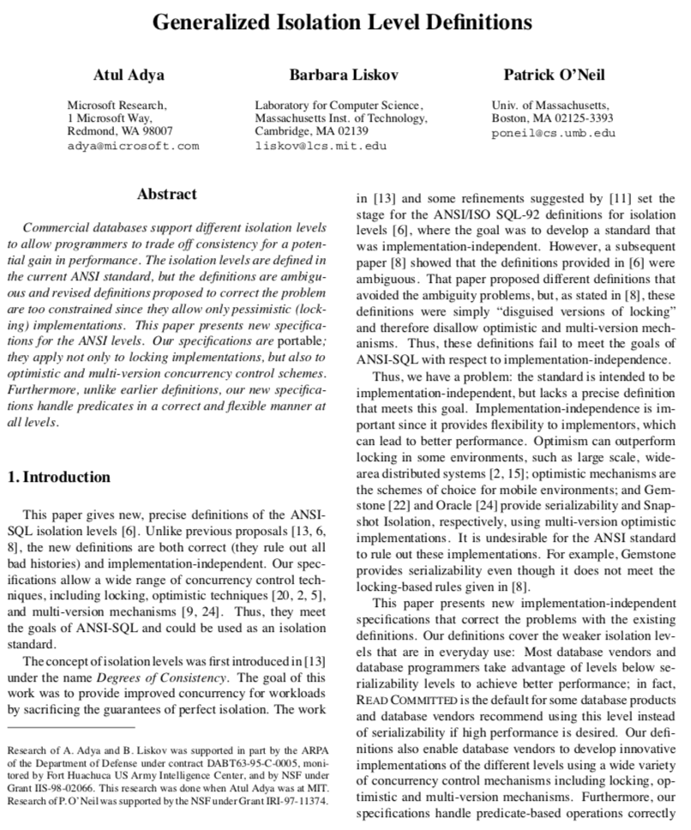
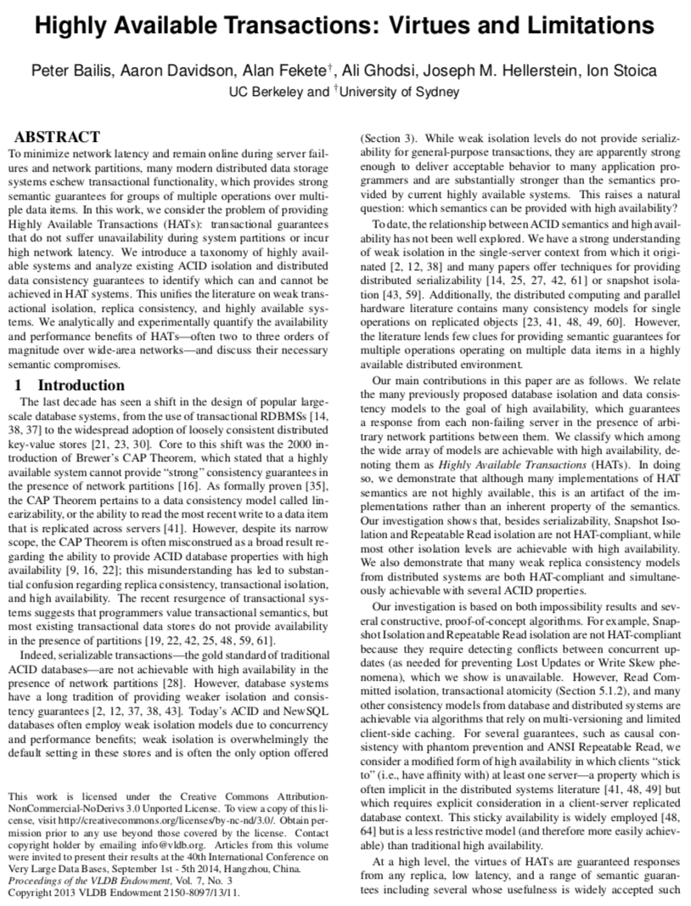
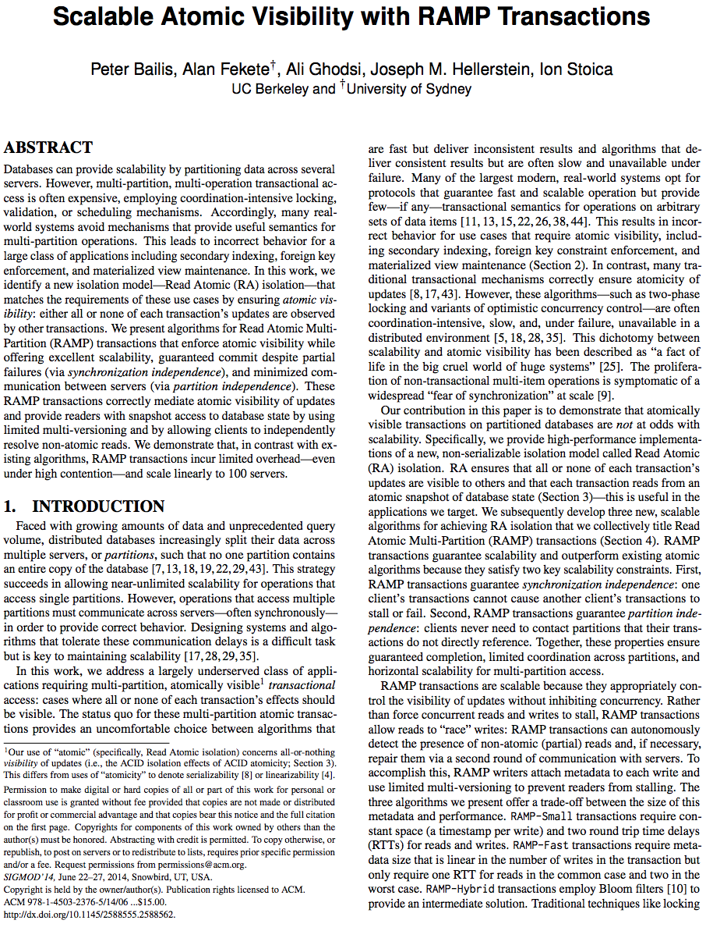
Test Coverage
Atomicity;
Commit
Rollback
Isolation;
Dirty Writes¹, Aborted Reads¹, Intermediate Reads¹, Circular Information Flow¹, Write Skew¹, Lost Updates¹, Item-Many Preceders², Predicate-Many Preceders², Observed Transaction Vanishes², and Fractured Reads^{3.}
Adya et al. ¹
Generalized Isolation Level Definitions,
ICDE 2000
Bailis et al. ²
Highly Available Transactions: Virtues & Limitations,
VLDB 2014
Bailis et al. ³
Scalable Atomic Visibility with RAMP Transactions,
SIGMOD 2014

Slide 13
Example: Lost Updates
A lost update occurs when 2 transactions concurrently attempt to make conditional modifications to the same data item(s)
R(X,5)
W(X,6)
T1
R(X,5)
W(X,6)
T2
If T1 and T2 are executed sequential, X=7, T2’s update is ”lost”

Slide 14
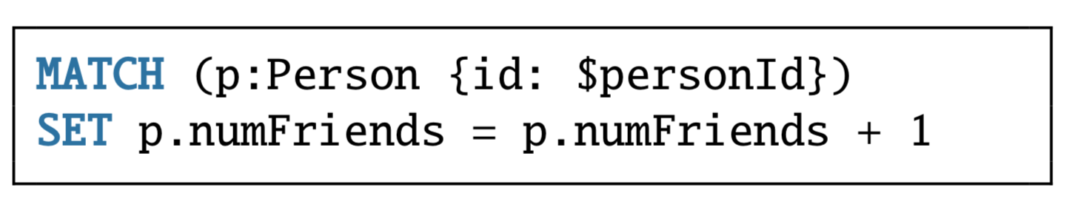
Example: Lost Updates
Person
Load a test graph containing Person nodes, with unique id and numFriends properties
Clients choose a random Person and increment its numFriends property
Clients store local counters (expNumFriends) for each Person, which is incremented each time a Person is selected and the transaction successfully commits
After execution, gather counters, then,
Perform anomaly check: for each Person,
(global) expNumFriends = (observed) numFriends
$id
$numFriends

Slide 15
Experimental Setup
Implemented as extensible framework in a Java application
Ubuntu 18.04 running AdoptOpenJDK 11.0.4.hs
4 graph database systems and 1 relational database;
Neo4j 3.5.20 and 4.1.1
Memgraph 1.0
Dgraph 20.07.0
JanusGraph 0.5.2 (BerkeleyDB 7.5.11 and Cassandra 3.11.0 backends)
PostgreSQL 9.6
For all systems, we used their declarative query languages (Cypher, GraphQL, Gremlin, and SQL) and the officially recommended Java drivers

Slide 16
Results
Overall, most systems met their claims
Selected results;
Memgraph’s default isolation level is Snapshot Isolation; only Write Skew occurred
Neo4j’s default isolation level is Read Committed with some built-in protection again Lost Updates; v3.5.20 and v4.1.1 met requirements for Read Committed, but v4.1.1 displayed Lost Updates
JanusGraph had the worst user experience, passing some tests due to serving extremely stale reads; also, execution of some tests timed out
Dgraph’s default isolation level is Snapshot Isolation; passed our Write Skew test

Slide 17
Future Work
Included test suite in LDBC Auditing Policies;
Used test suite in recent audit of FMA’s TuGraph
Extend test suite to incorporate complex consistency constraints;
Graph databases generally do not support constraints; sometimes domain and primary key constraints
Graph-specific constraints are expected to be introduced;
(Partial) compliance to a schema on top of property graphs,
Structural constraints, e.g., connectedness of the graph, absence of cycles, or arbitrary well-formedness constraints
LDBC PGSWG actively working in this area
Add tests for distributed graph processing systems

